Slide 1

Cloud Security

Slide 2
AWS Services
Amazon Web Services (AWS) offers over 200 fully featured services, acting as a flexible pay-as-you-go platform. That are:
on-demand cloud services
Including computing power
Storage
Databases
AI
Key services include: EC2 (virtual servers), S3 (object storage), Lambda (serverless computing), and RDS (managed databases).
These tools enable scaling, security, and innovation for startups to enterprises.

Slide 3
Core AWS Services Categories
Compute: Amazon EC2 (virtual servers), AWS Lambda (serverless), Amazon ECS/EKS (containers).
Storage: Amazon S3 (object storage), Amazon EBS (block storage), Amazon S3 Glacier (archiving).
Database: Amazon RDS (relational), Amazon DynamoDB (NoSQL), Amazon Aurora (high-performance relational).
Networking: Amazon VPC (isolated network), Amazon CloudFront (content delivery), Elastic Load Balancing.
AI/Machine Learning: Amazon SageMaker (model building), Amazon Lex (chatbots), Amazon Recognition (image analysis).
Security & Identity: AWS IAM (access management), AWS Shield (DDoS protection), AWS Key Management Service (KMS).

Slide 4
Top AWS Services
Service Name | Category | Primary Use
Amazon EC2 | Compute | Providing virtual servers (instances) to run applications, ranging from small websites to massive data processing nodes.
Amazon S3 | Storage | Storing and retrieving any amount of data (images, videos, backups, data lakes) with extremely high durability.
AWS Lambda | Compute | Running code in response to events (serverless) without managing any underlying server infrastructure.
Amazon RDS | Database | Setting up, operating, and scaling relational databases (like MySQL, PostgreSQL, or SQL Server) in the cloud.
Amazon DynamoDB | Database | A serverless NoSQL database designed for high-performance applications that need consistent, single-digit millisecond latency.

Slide 5
AWS IAM
AWS IAM service that helps us securely control access to AWS resources.
With IAM, we can centrally manage permissions that control which AWS resources users can access
IAM can be used to control who is authenticated (Signed In) and authorized (Has permissions) to use resources.
All security in AWS is managed through IAM (Identity and Access Management).
IAM Core Concepts
  1. Users
  2. User Groups
  3. Roles
  4. Policy

Slide 6
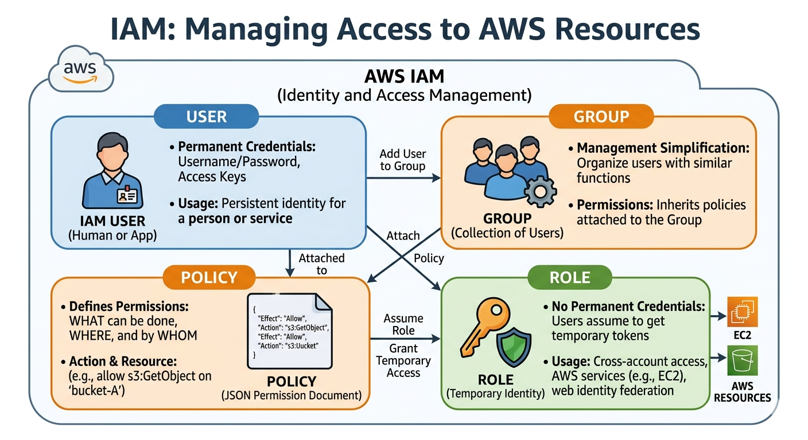
Understanding IAM
Understanding IAM: User, Group, Policy, and Role

Slide 7
Understanding IAM
1. User
An IAM user can represent a person or an application that uses its credentials to make AWS requests.
A User is an identity you create in AWS for a specific person or application.
Credentials: They usually have a name and a permanent password (for the Console) or Access Keys (for the CLI/API).
Usage: Best for long-term access for individual employees or a specific software service.

Slide 8
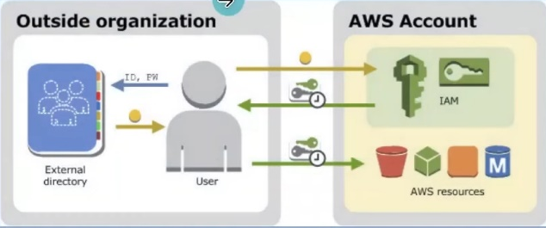
Understanding IAM
User
Root User
IAM User (Long Term Credentials)
Federated User (Temporary Credentials)

Slide 9
Understanding IAM
2. User Group
An IAM user group is a collection of IAM users.
User groups let you specify permissions for multiple users, which can make it easier to manage the permission for those users.
Purpose: It makes management easier. Instead of giving 10 different developers the same permissions one by one, you create a "Developers" group and add them all to it.
Key Rule: Groups cannot contain other groups (no nesting).

Slide 10
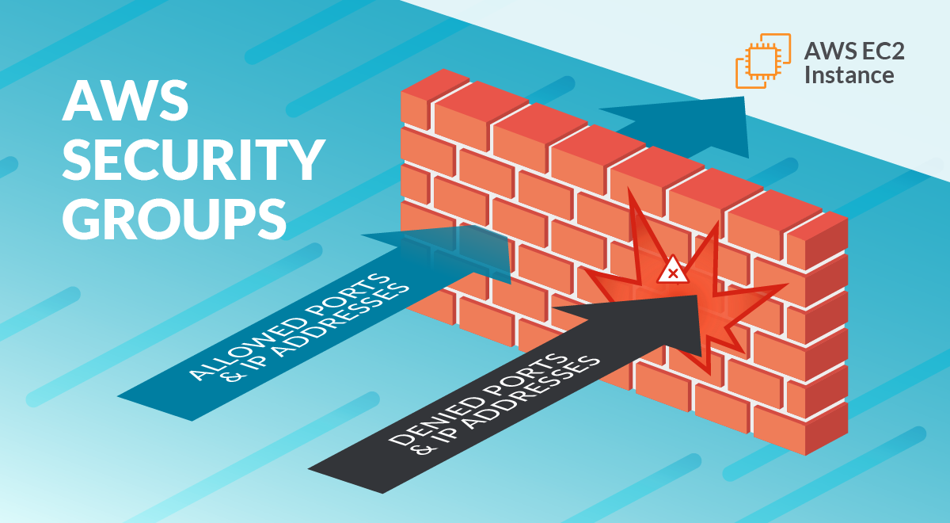
Understanding IAM
2. User Group
A security group is like having bodyguards for your virtual machines (EC2 instances) in the cloud.
These bodyguards protect your instances by controlling who can come in (inbound) and who can go out (outbound).

Slide 11
Understanding IAM
3. Policy
A Policy is a JSON document that defines what can be done. It is the actual list of "permissions."
Structure: It specifies an Effect (Allow/Deny), an Action (e.g., s3:GetObject), and a Resource (e.g., a specific S3 bucket).
Attachment: Policies don't do anything on their own; they must be attached to a User, Group, or Role to take effect.

Slide 12
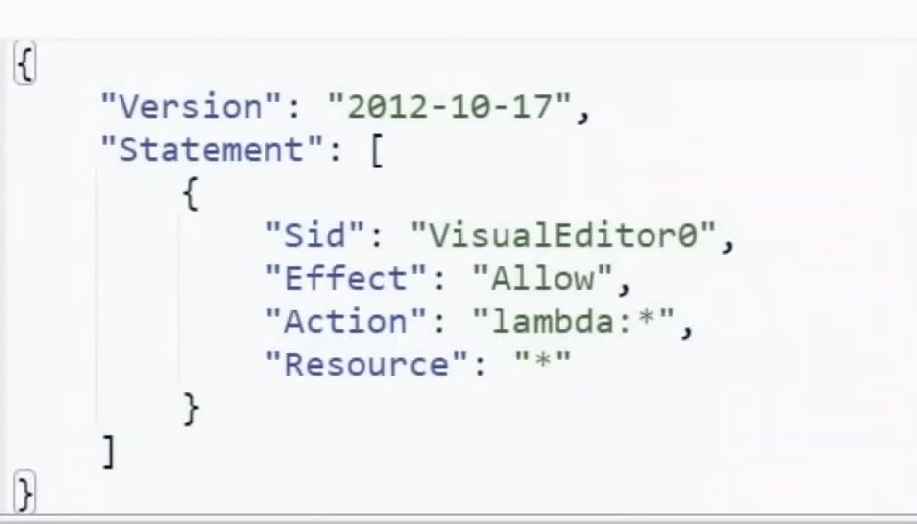
Understanding IAM
3. Policy
An IAM Policy is the actual document that defines permissions. It is written in JSON (JavaScript Object Notation) and follows a specific structure.
Here is a standard example of a policy that allows a user or role to read files from a specific S3 bucket but denies them the ability to delete anything.
IAM Policy
JSON document, which defines the permissions
Can be attached to IAM Role or IAM User
Two types- AWS Managed and Customer Managed

Slide 13
Understanding IAM
3. Policy
{
"Version": "2012-10-17",
"Statement": [
{
"Sid": "AllowListAndRead",
"Effect": "Allow",
"Action": [
"s3:ListBucket",
"s3:GetObject"
],
"Resource": [
"arn:aws:s3:::my-example-bucket",
"arn:aws:s3:::my-example-bucket/*"
]
},
{
"Sid": "DenyDelete",
"Effect": "Deny",
"Action": "s3:DeleteObject",
"Resource": "arn:aws:s3:::my-example-bucket/*"
}
]
}
Breakdown of the Policy Components:
Version: The policy language version. Always use "2012-10-17" (the current standard).
Statement: The main container for the policy rules. You can have multiple statements in one policy.
Sid (Statement ID): An optional description to help you identify what this specific block does.
Effect: Either Allow or Deny. Note that in AWS, an explicit Deny always overrides an Allow.
Action: The specific API calls you are permitting or forbidding. (e.g., s3:GetObject lets you download a file).
Resource: The specific AWS asset this applies to. In S3, arn:aws:s3:::bucketname/* refers to all objects inside that bucket.

Slide 14
Security Group
4. Role
A Role is a temporary identity that can be "assumed" by anyone who needs it—even another AWS service.
No Permanent Credentials: Unlike a User, a Role does not have a password. It provides temporary security tokens.
Usage: Use these when you want to give an EC2 instance permission to access an S3 bucket, or when giving temporary access to a user from another AWS account.
IAM Role
Similar to IAM User (Has Permission Policies)
But no long-term credentials and is not associated with a particular user
Can be assumed by anyone who needs it.

Slide 15
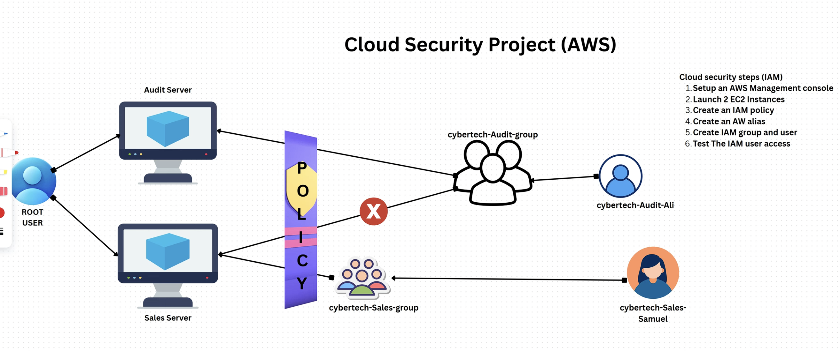
Cloud Security Project

Slide 16
Thankyou

